Slide 1

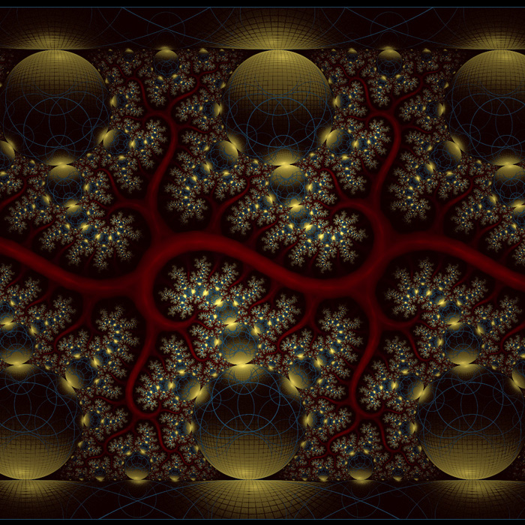






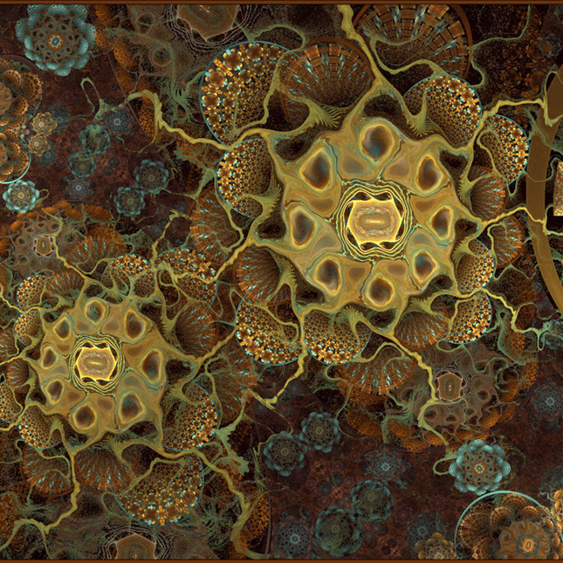







A Experiment 1 (hard)
Fractal Set 1
B Experiment 2 (easy)
Fractal Subset 1
Category Learning Task:
Exemplars: 1 – 4 Category 1 (Northern Hemisphere)
Exemplars: 5 – 8 Category 2 (Southern Hemisphere)
Category Learning Task:
Exemplars: 1 – 2 → Category 1 (Northern Hemisphere)
Exemplars: 3 – 4 → Category 2 (Southern Hemisphere)
C Fractal Set 2
D Fractal Set 2
Category Learning Task:
Exemplars: 1 – 4 Category 1 (Northern Hemisphere)
Exemplars: 5 – 8 Category 2 (Southern Hemisphere)

Slide 2
A Experiment 1 (hard)
Fractal Set 1
B Experiment 2 (easy)
Fractal Subset 1
Category Learning Task:
Exemplars: 1 – 4 Category 1 (Northern Hemisphere)
Exemplars: 5 – 8 Category 2 (Southern Hemisphere)
Category Learning Task:
Exemplars: 1 – 2 → Category 1 (Northern Hemisphere)
Exemplars: 3 – 4 → Category 2 (Southern Hemisphere)
C Fractal Set 2
D Fractal Set 2
Category Learning Task:
Exemplars: 1 – 4 Category 1 (Northern Hemisphere)
Exemplars: 5 – 8 Category 2 (Southern Hemisphere)

